Slide 1
Comprehensive Audit and Analysis for Effective Digital Presence

Slide 2
Description:
Zoho Corporation, originally founded as AdventNet, Inc. in 1996 by Sridhar Vembu and Tony Thomas in New Jersey, USA, is now headquartered in Chennai, Tamil Nadu, India, with offices in over 80 countries and its US headquarters in Austin, Texas.
Zoho is an Indian multinational technology company.
It develops cloud-based software for businesses.
Popular products include CRM, email services, accounting software, and project management tools.
Zoho helps companies manage operations digitally.
Zoho employs over 10,000 people globally.

Slide 3

Task -2 Website Audit Report
1️⃣ SEO Analysis
Title tag

Slide 4
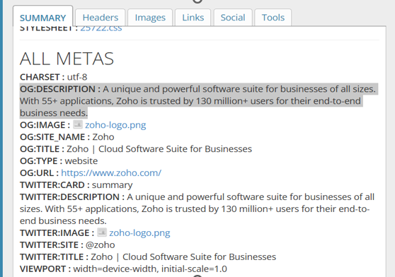
SEO Audit – Meta Description
Meta Description Analysis:
The website uses a well-optimized meta description.
It clearly explains the purpose of the business.
It includes important keywords like:
software suite
businesses
applications

Slide 5
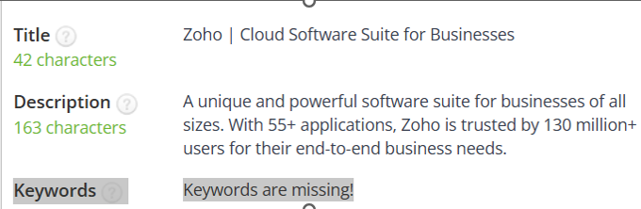
SEO Audit – Keywords
Keyword Analysis:
The website uses relevant and high-ranking keywords.
Keywords are related to business software and cloud solutions.
Primary keywords are well placed in:
Meta title
Meta description
Headings
Examples of Keywords:
CRM software
Business applications
Cloud-based solutions

Slide 6
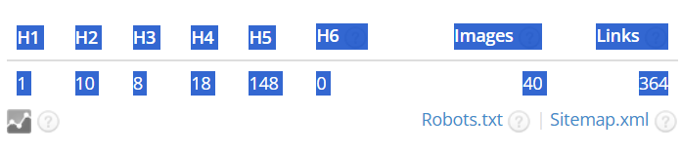
SEO Audit – Heading Structure
Heading Structure Analysis:
The website uses a proper heading hierarchy.
Only one H1 tag is used, which is good for SEO.
Multiple H2 and H3 tags are used to organize content.
Heading structure (H1, H2)

Slide 7
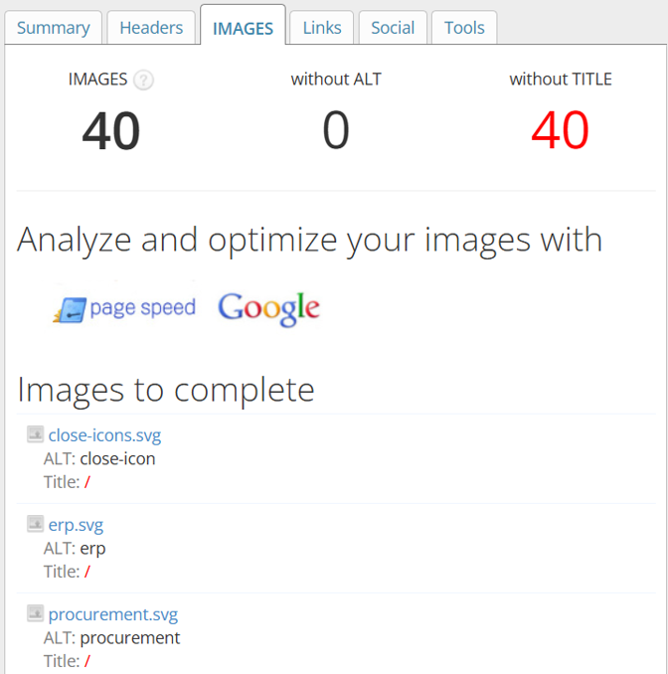
SEO Audit – Image Optimization
Image SEO Analysis:
The website contains 40 images.
All images have ALT attributes, which is good for SEO and accessibility.
However, image TITLE attributes are missing.

Slide 8
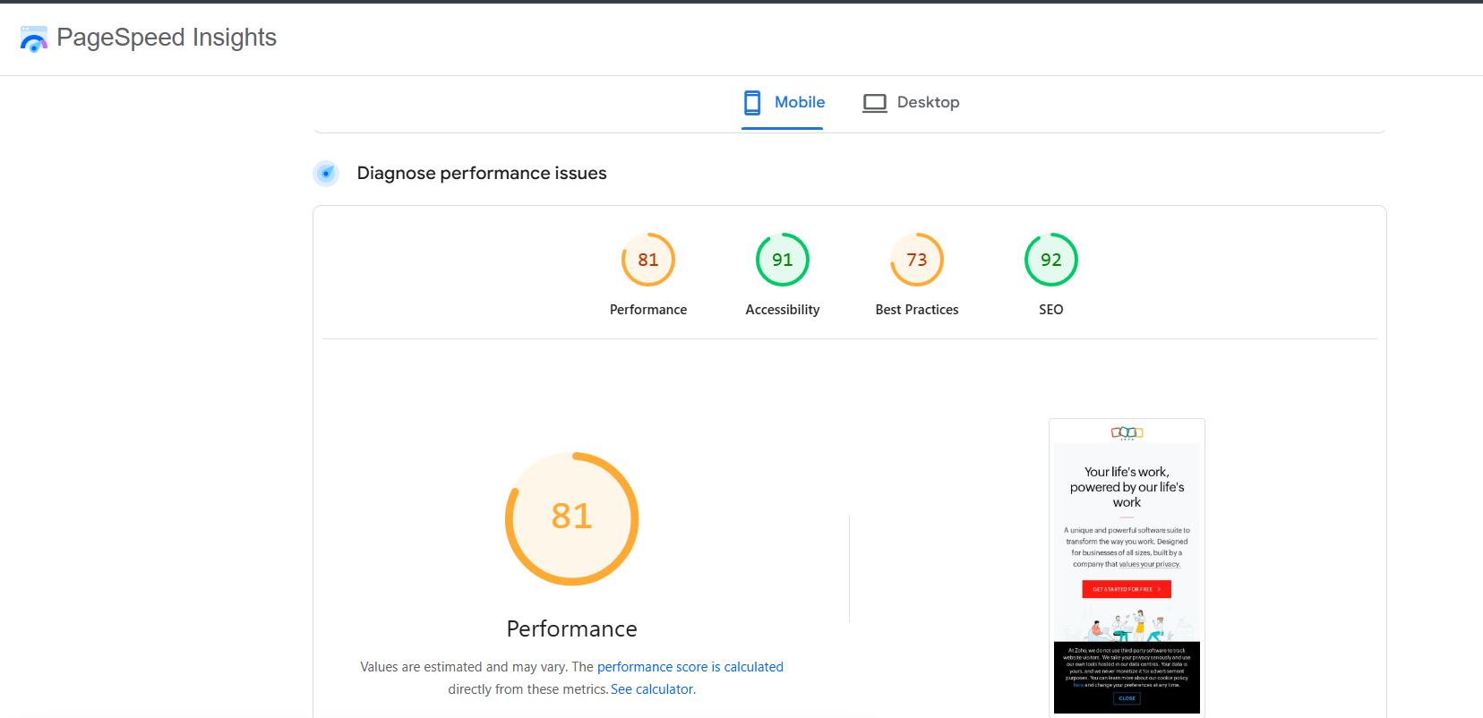
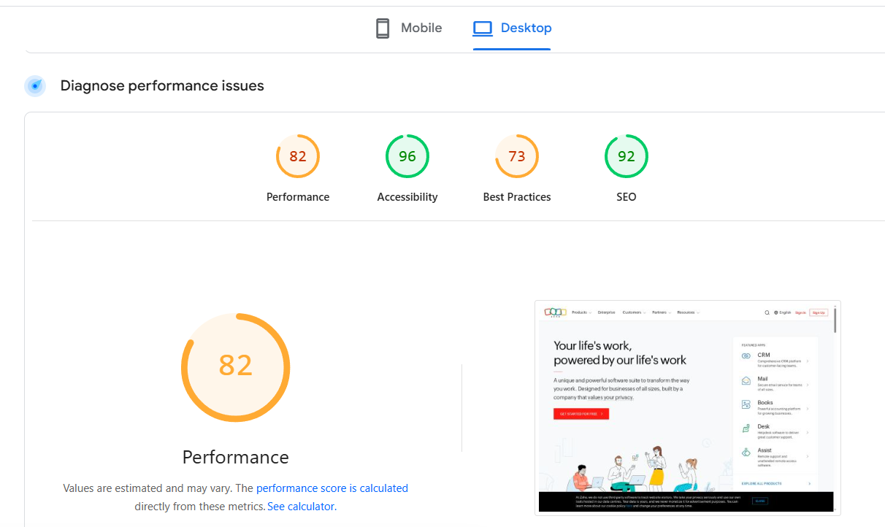
Page Speed Test

Slide 9
Responsive Design Analysis
Tool Used: Responsive Design Checker
Analysis:
The website is fully responsive across different screen sizes.
It adapts well to desktop, tablet, and mobile devices.
Content, images, and buttons are properly aligned.

Slide 10
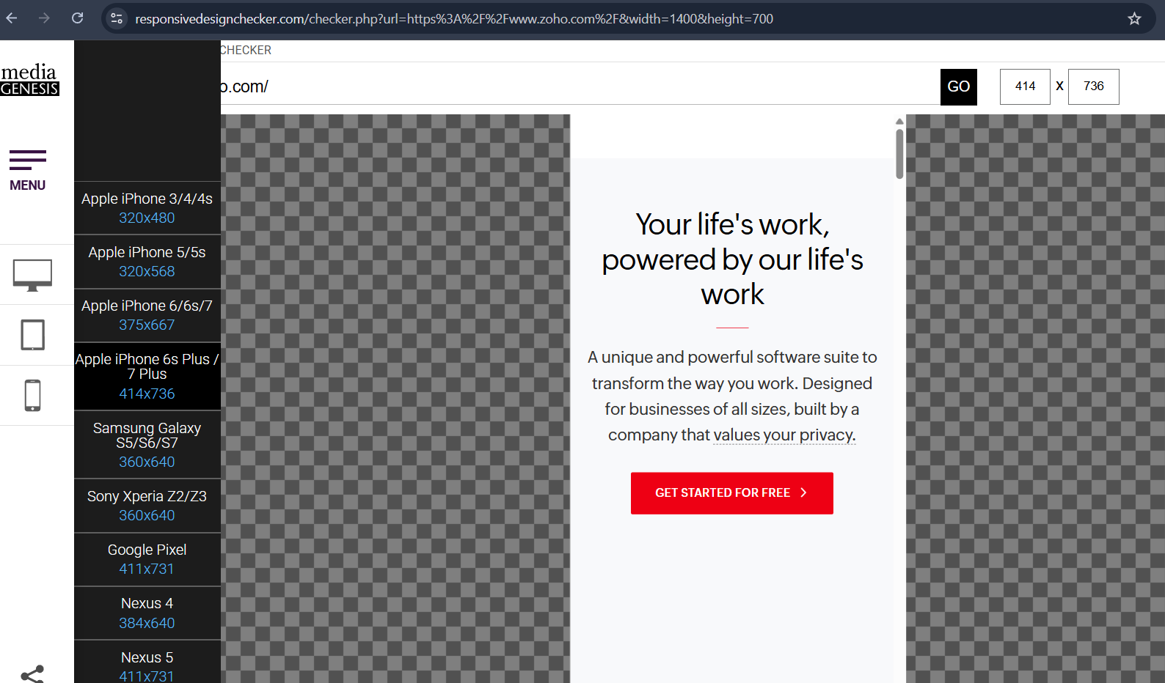
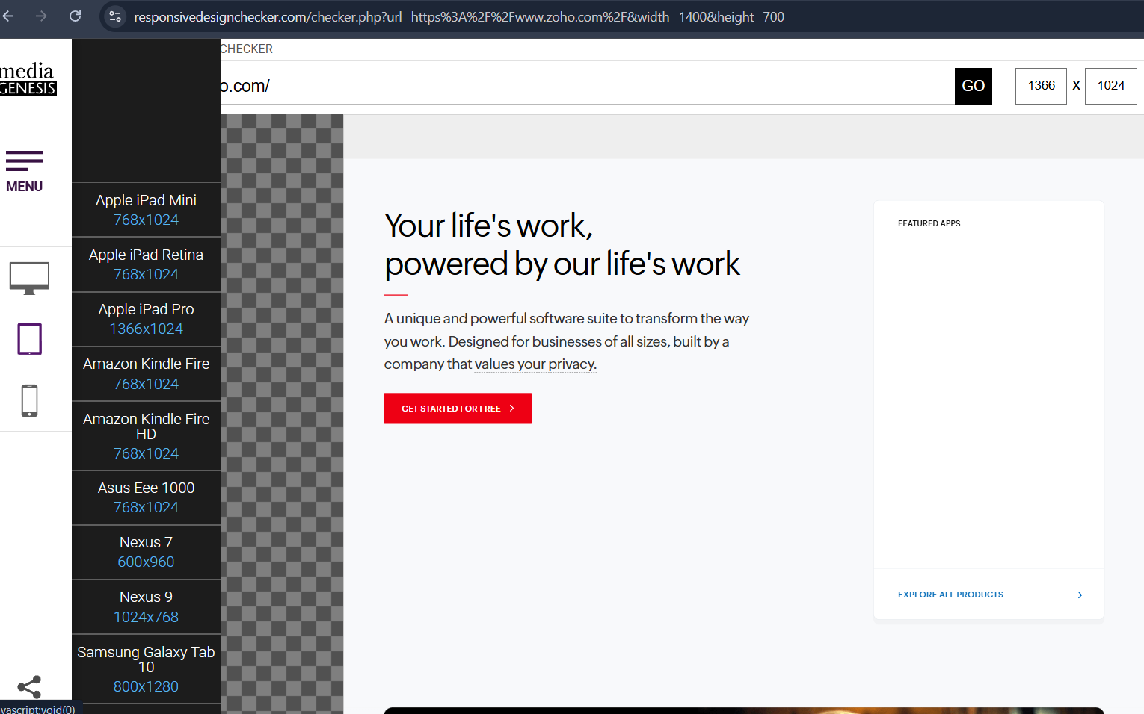
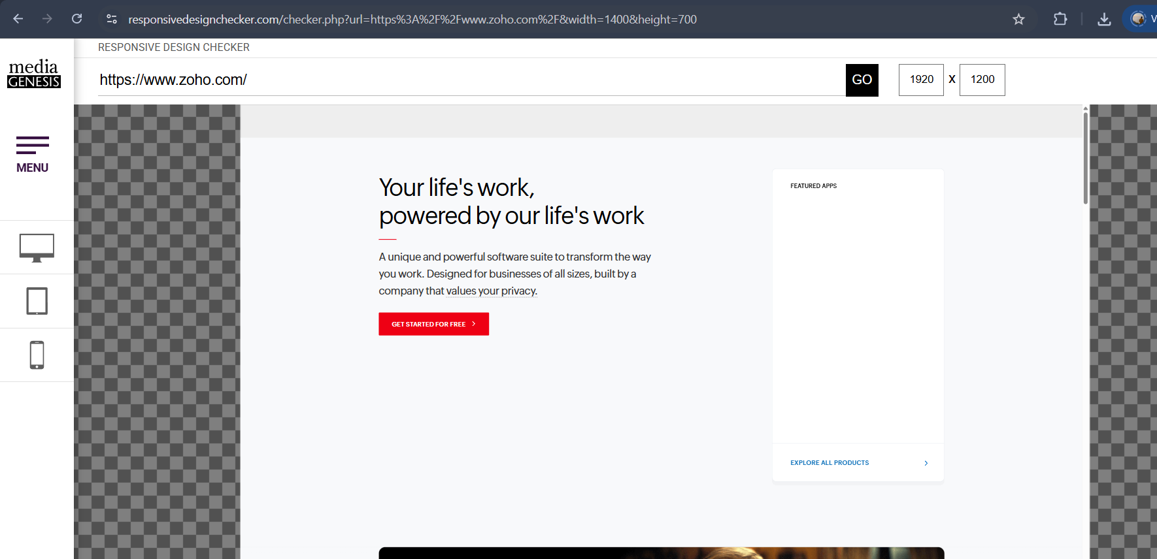

Slide 11
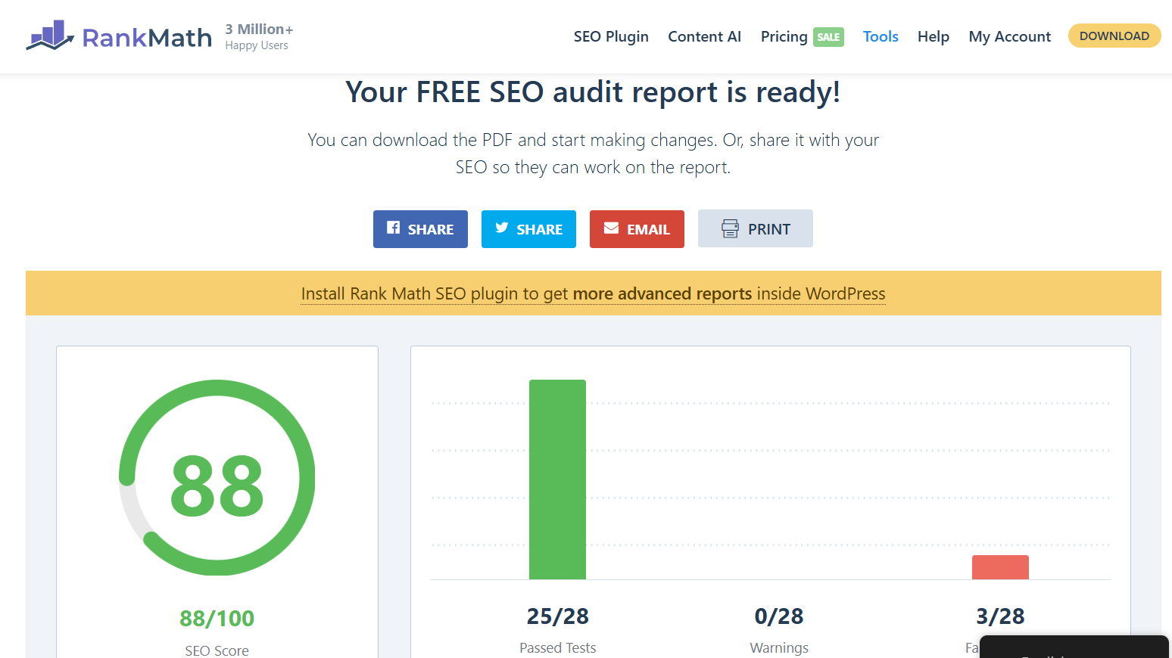
User Experience (UX) Analysis
UX Analysis:

Slide 12
Digital Marketing Strategy
Recommended Strategies:
SEO Strategy
Improve keyword optimization
Use long-tail keywords
Increase internal linking
Content Marketing
Publish blogs and tutorials
Create video content
Add case studies
Social Media Marketing
Increase engagement on social platforms
Post regularly
Use video content
Email Marketing
Send personalized emails
Promote offers and free trials
Share newsletters

Slide 13
https://zohodemo6.wordpress.com/zoho-crm-landing-page/

Slide 14
Thank you

